Slide 1
English learning Game
Roi Shricki & Itay Itzhak
Holon institute of technology

Slide 2
01
Introduction
The subject of our proposal is a game for teaching English to children
Our game has two game modes for learning
The first option would be to display a word in Hebrew and the player will have to say it in English
A second option would be to hear a word in English and the player would have to write it in English

Slide 3
How does it work?
First Game
Second Game
This game GOOGLE's text to speech API
The program creates 10 WAV files for each level
The player pressed a button to hear the word.
The player inserts his answer into the textbox
The program compares the words, if it is the same - The player moving to the next level.
This game uses Google's speech to text API.
The player recording himself say the word on screen.
Google API analyzes WAV file and returns us a string
The program makes a comparison of the string
against the correct word.

Slide 4
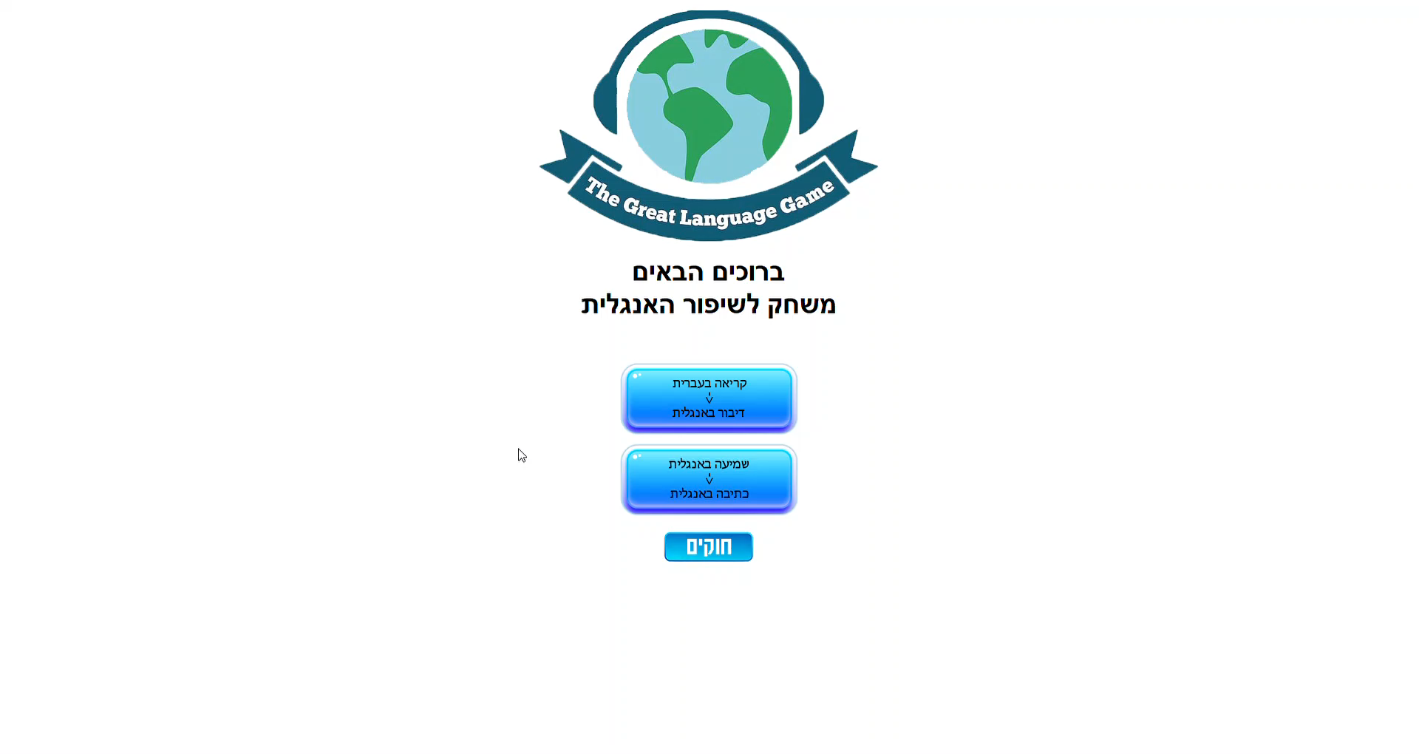
Trailer Game 1

Slide 5
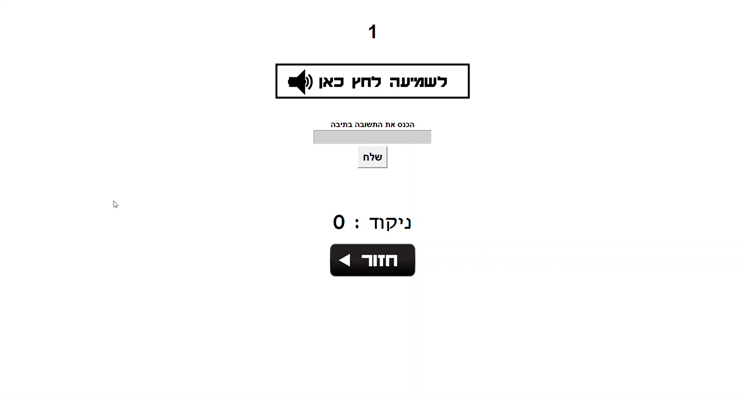
Trailer Game 2

Slide 6
GUI
Game 2
Game 1
Text
WAV file
Input text
Google API
TTS/STT
REC WAV file
WAV file
Text
WAV file from Google
String from Google
Return feedback
Return feedback
GUI/USER

Slide 7
Planning and execution
Tkinter
Google.cloud
Pyaudio
Soundfile
Write the code in python with GUI and connect to google API
Used with :
Library for GUI
Library for TTS and STT
Library for record files
Library for audio

Slide 8
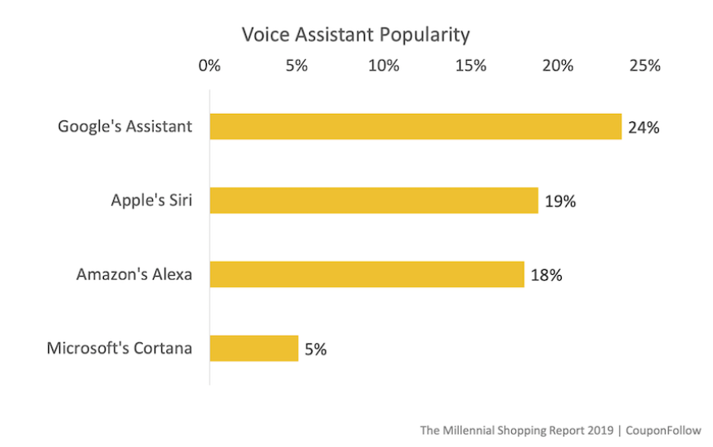
Why Google Assistant API?

Slide 9
Screenshots and sources from the games

Slide 10
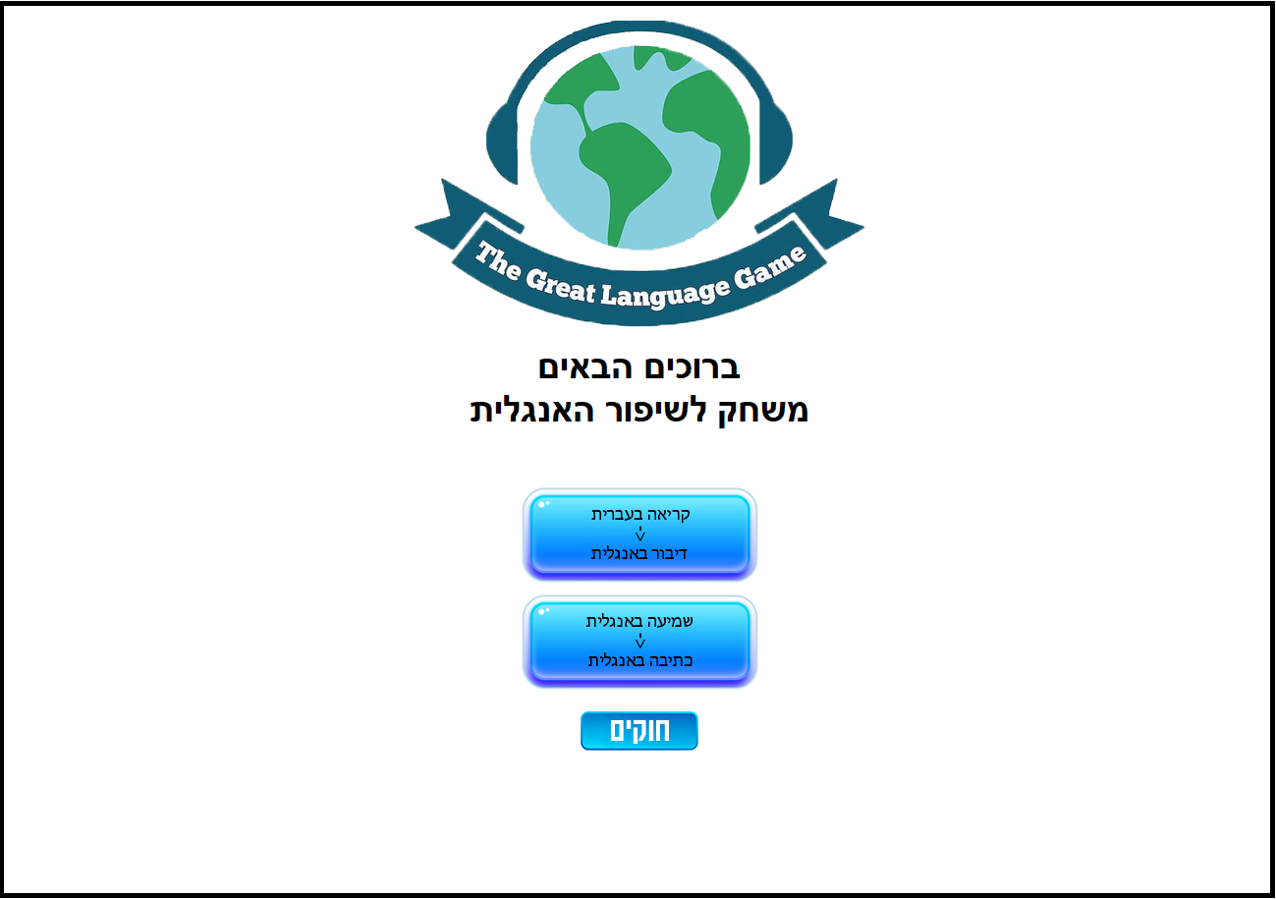
GUI - Main

Slide 11
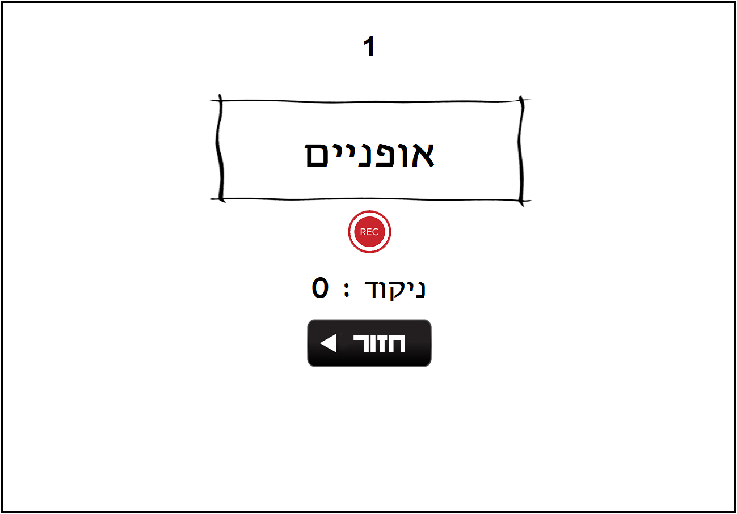
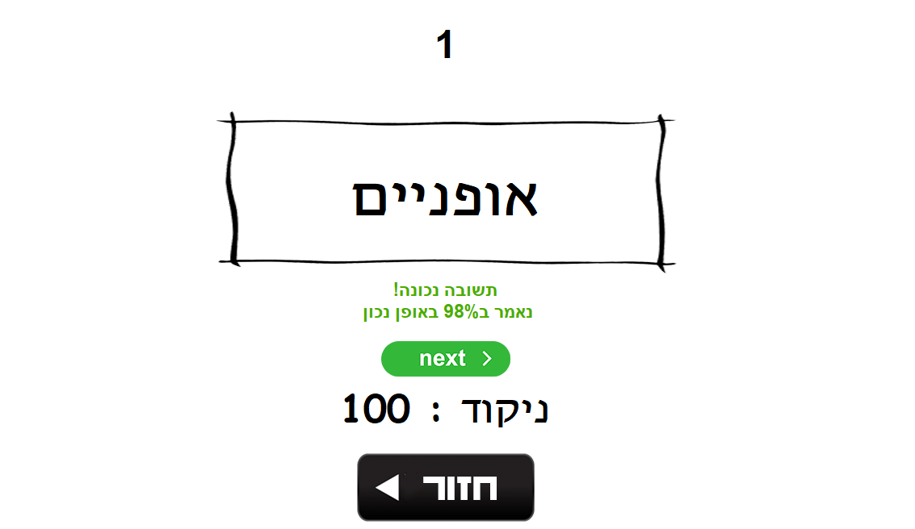
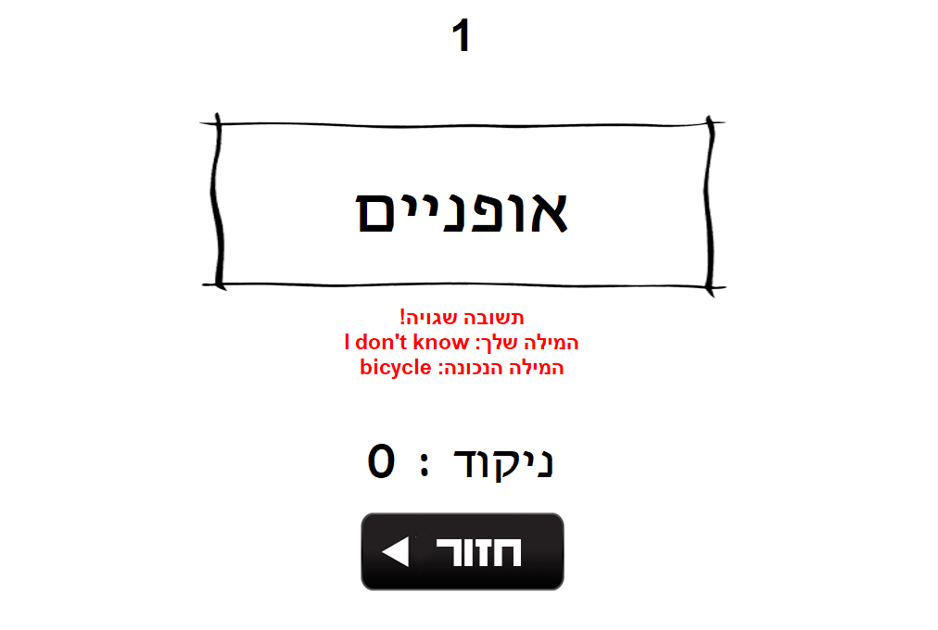
GUI – Game 1

Slide 12
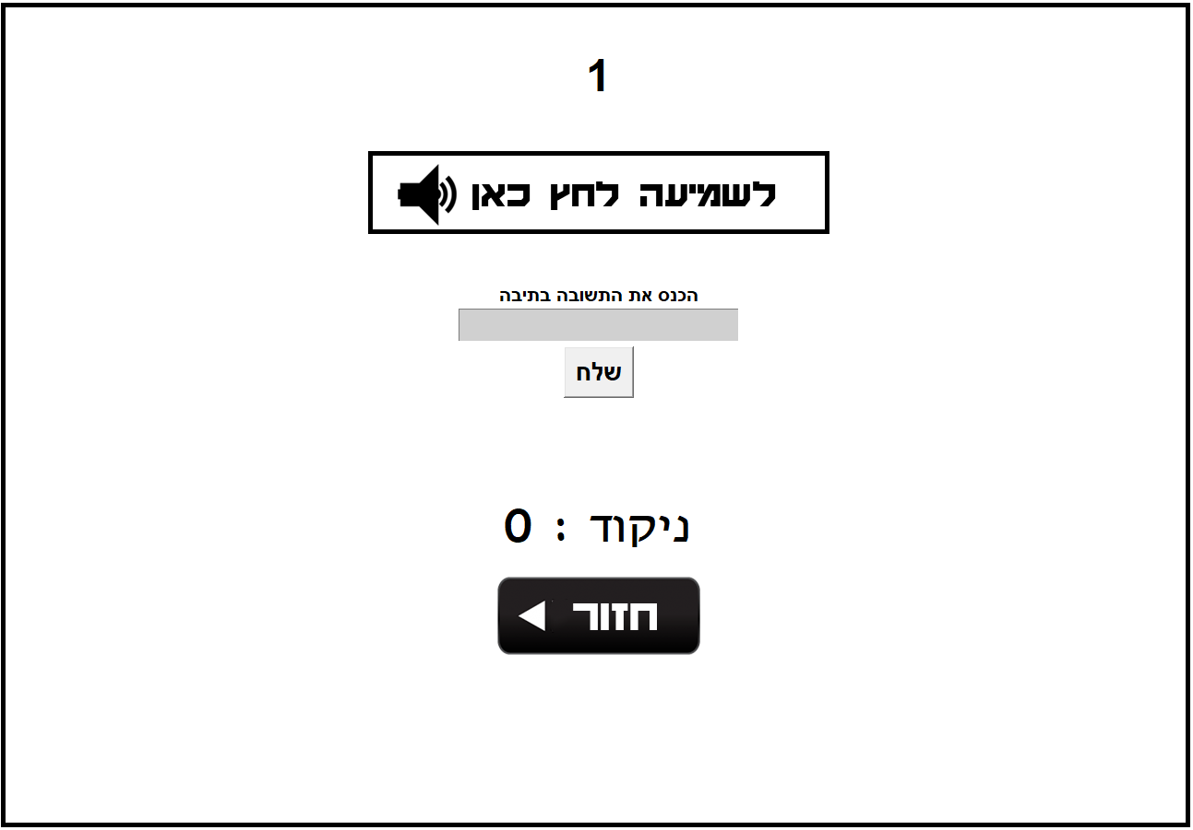
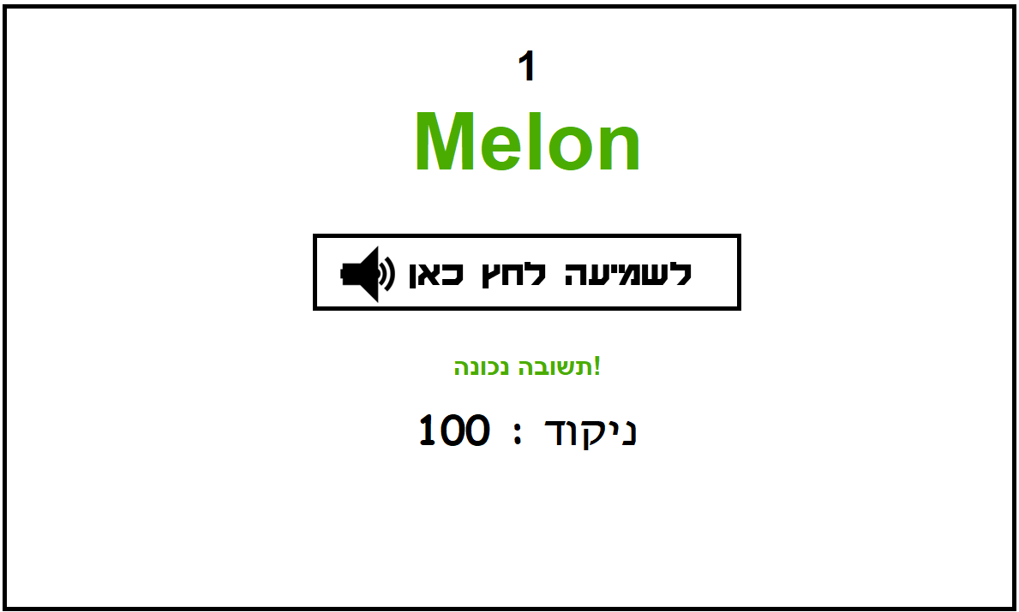
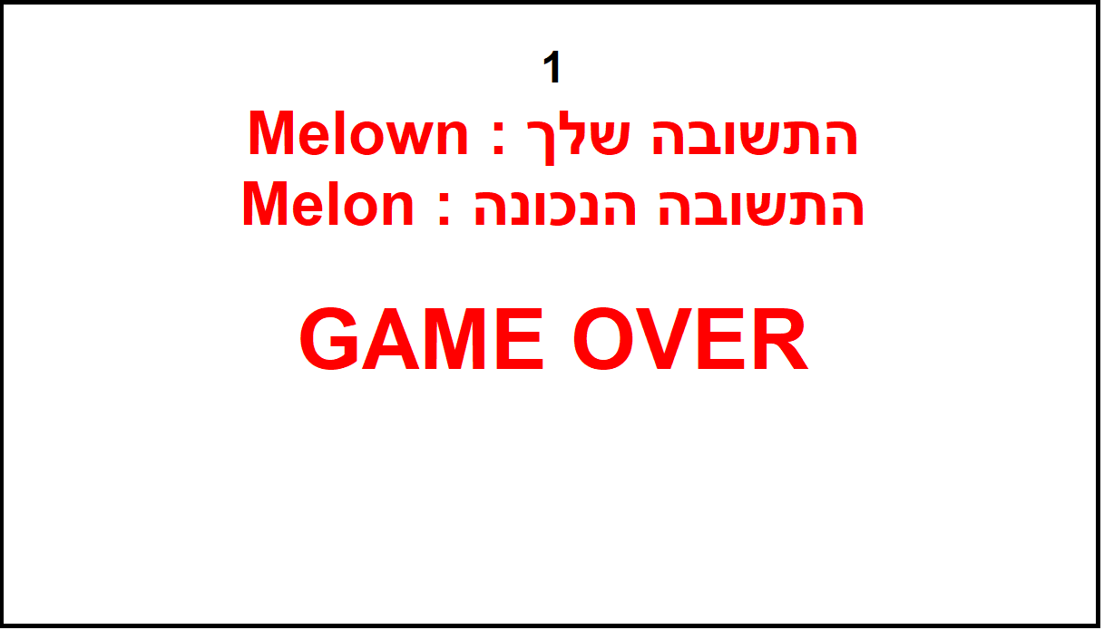
GUI – Game 2

Slide 13
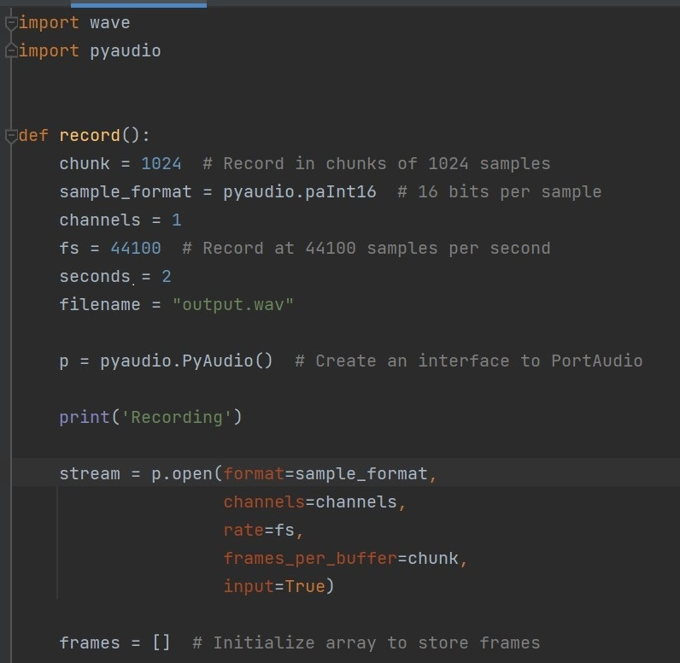
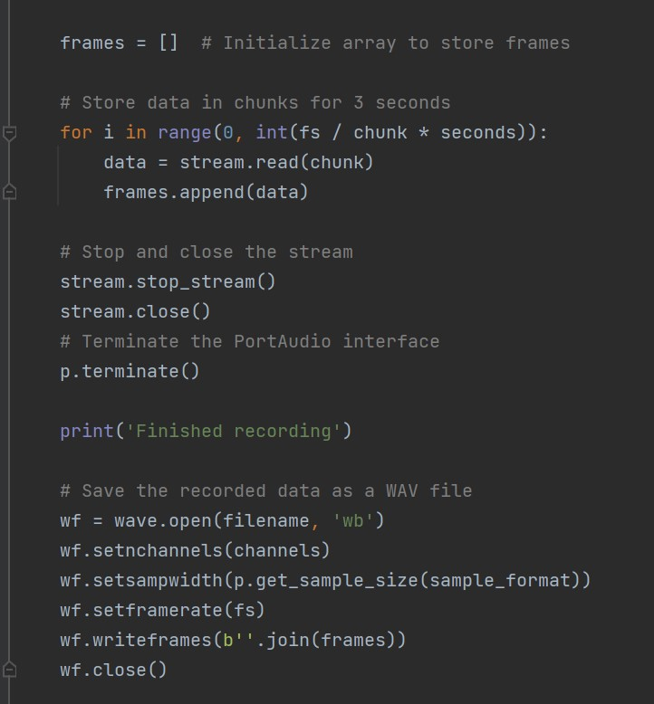
Source code – Record WAV file

Slide 14
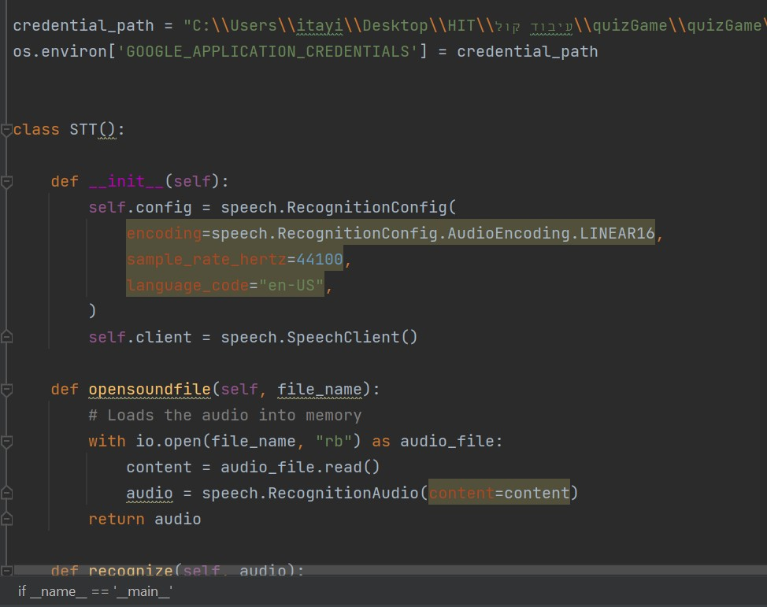
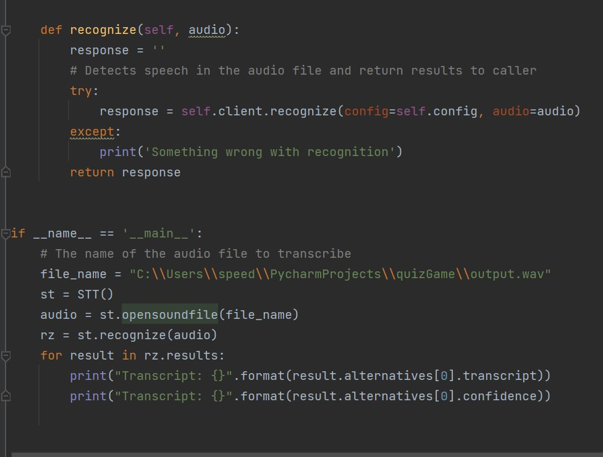
Source code – STT class

Slide 15
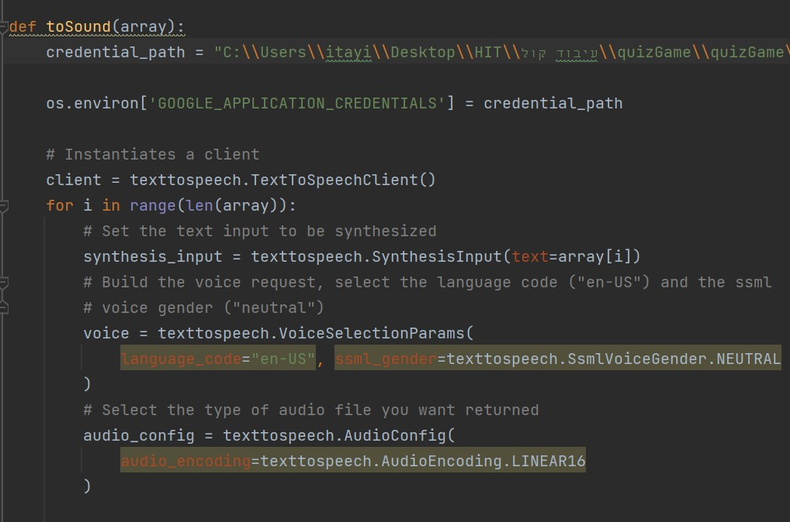
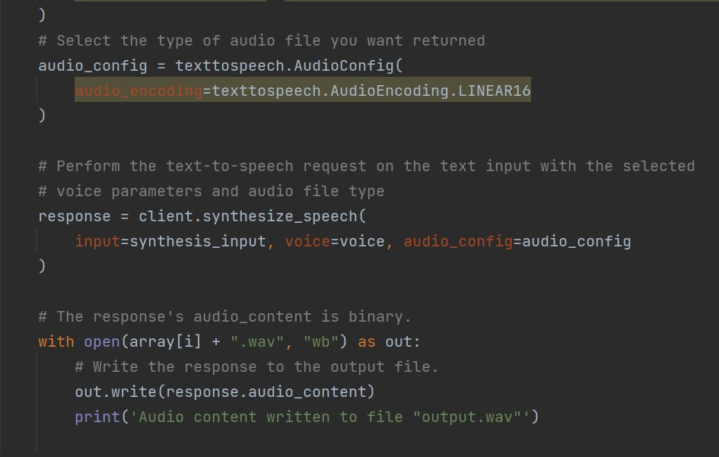
Source code – TTS class

Slide 16
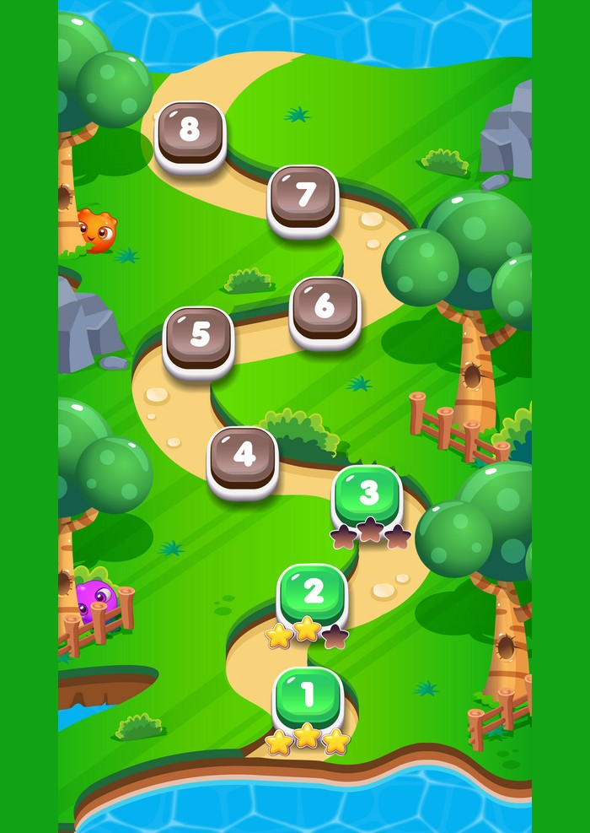
Conclusions and insights
Database
Better GUI
User Progress
Personal UX
01
02
A database containing users' scores and their progress
A more child-friendly graphic user interface
03
04
make it a more personal experience for the users with sentences like "Great move Nava!" and "Try again Nava"
Creating a personal progression-line from the easy levels to the hard levels for each user

Slide 17
Bibliography and sources
-
Foreign and second language anxiety
-
GAME-BASED LEARNING FOR SPEAKING PRACTICES IN ESL CONTEXTS.
”
-
User Experience Comparison of Intelligent Personal Assistants: Alexa, Google Assistant, Siri and Cortana

Slide 18
Thank You!

